Slide 1
Digital Portfolio
STUDENT NAME: S. Supriya
REGISTER NO AND NMID: 24132041802522033
DEPARTMENT:B. SC COMPUTER SCIENCE
COLLEGE: COLLEGE/ UNIVERSITY:SIRMATH SIVANA BALAYASWAMIGAL/ANNAMALAI

Slide 2
PROJECT TITLE
WEB DEVELOPMENT

Slide 3


AGENDA
Problem Statement
Project Overview
End Users
Tools and Technologies
Portfolio design and Layout
Features and Functionality
Results and Screenshots
Conclusion
Github Link
3/21/2024 Annual Review

Slide 4

PROJECT OVERVIEW
Key Features 1. *Product Catalog*: Display products with images, pricing. 2. *Search & Filters*: Search and filter by category, price. 3. *Cart & Checkout*: Shopping cart with payment gateway (Stripe/PayPal). 4. *User Auth*: Registration, login. 5. *Admin Panel*: Manage products, orders. 6. *Responsive*: Mobile-friendly design.

Slide 5

WHO ARE THE END USERS?
Primary End Users 1. *Customers:Browse, search, purchase products/services. 2. *Administrators: Manage website content, users, orders. 3. *Content Creators: Authors, bloggers posting content. Other Users 1. *Employers/ Businesses*: Post jobs, manage applications (job portals). 2. *Job Seekers: Search and apply for jobs. 3. *Subscribers: Receive newsletters, updates.

Slide 6

TOOLS AND TECHNIQUES
Frontend
1. *Frameworks*: React.js, Angular, Vue.js
2. *Libraries*: jQuery
3. *Styling*: CSS3, Sass, Bootstrap, Tailwind CSS
4. *Build Tools*: Webpack, Vite
Backend
1. *Languages*: Node.js (JavaScript), Python, Ruby, PHP
2. *Frameworks*: Express.js (Node), Django (Python), Rails (Ruby)
3. *Databases*: MySQL, PostgreSQL, MongoDB
Tools
1. *Version Control*: Git (GitHub, GitLab)
2. *APIs*: REST, GraphQL
Web Development Results & Screens
Common Screens
1. *Homepage*: Entry point, often showcases key content/products.
2. *Product Page*: Details of a product (e-commerce).
3. *Login/Register*: User authentication screens.
4. *Dashboard*: User-specific area post-login.
5. *Contact/About*: Info about company/person.
Key Results
1. *Responsive Layouts*: Adapt to various screen sizes.
2. *Interactive Elements*: Buttons, forms reacting to user actions.
3. *Dynamic Content*: Updates without full page reload (AJAX, APIs).
4. *User Feedback*: Notifications, success/error messages.
5. *SEO Optimization*: Pages optimized for search engines.
Example Screens
1. *Login Screen*: Username/password fields, submit button.
2. *Product Listing*: Grid/list of products with images, prices.
3. *Checkout Screen*: Payment details, order summary (e-commerce).
4. *404 Error Page*: Handles page not found scenarios.
Would you like wireframes or examples of specific screens for a web application?

Slide 7
POTFOLIO DESIGN AND LAYOUT
KeysElements
1. *Homepage*: Brief intro, showcase projects.
2. *Projects Section*: Grid/layout of projects with images, descriptions.
3. *About Me*: Skills, experience, background.
4. *Contact*: Email, social links, contact form.
5. *Responsive Design*: Works on desktop, tablet, mobile.
Design Considerations
1. *Clean & Minimal*: Focus on work showcase.
2. *Typography*: Readable fonts.
3. *Color Scheme*: Professional, brand-aligned colors.
4. *Navigation*: Simple, intuitive menu.
Common Layouts
7

Slide 8
FEATURES AND FUNCTIONALITY
CorFeatures 1. *Responsive Design*: Adapts to desktop, tablet, mobile screens. 2. *User Authentication*: Login, registration, profile management. 3. *Search Functionality*: Search products, content, users. 4. *Forms & Data Handling*: Contact forms, data submission, validation.
5.*E-commerce Capabilities*: Product catalog, cart, checkout. Functionalities 1. *Interactivity*: Dynamic elements via JavaScript. 2. *API Integration*: Connect to external services (payment, maps). 3. *Content Management*: CRUD (Create, Read, Update, Delete) operations.

Slide 9
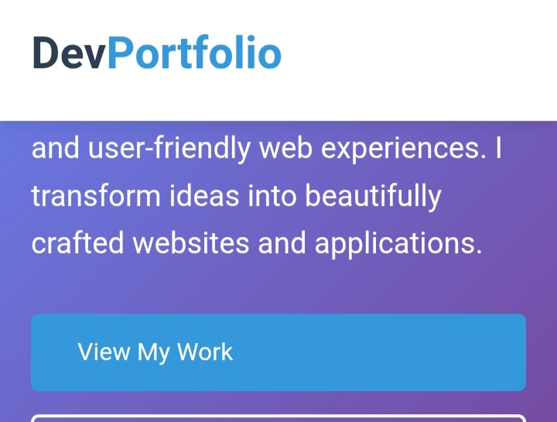

RESULTS AND SCREENSHOTS
3/21/2024 Annual Review
9

Slide 10
CONCLUSION
Key Takeaways 1. *Dynamic & Evolving*: Web tech constantly advances. 2. *User-Centric*: Focus on UX/UI for engagement. 3. *Responsive & Accessible*: Crucial for broad reach. 4. *Security & Performance*: Vital for trust & efficiency. 5. *Full Stack Skills*: Frontend, backend, database knowledge valuable. Web Development Enables 1. *Global Reach*: Websites/apps accessible worldwide. 2. *Business Growth*: Digital presence for businesses. 3. *Innovation*: PWA's, web apps push boundaries. 4. *Collaboration*: Tools like Git aid teamwork.
10

